Slide 1
Importance Of Nutrition For Optimal Short And Long Term Outcome In Preterm Infants

Slide 2
Introduction
27 million babies are born in India each year of which 3.6 million (13% ) babies are born preterm
0.76 million babies die in the neonatal period.
Prematurity is the major cause of neonatal deaths ( 35%)
>80% premature babies born between 32 - 37 weeks (moderate/late preterm)
Many die needlessly for lack of simple, essential care such as warmth and feeding support.
Preterm infants are at risk for poor growth while in SNCU and after discharge from the SNCU

Slide 3
Objectives Of This Webinar
In this webinar we will learn about :
Recommended Nutritional Goal For Preterm Babies
What is “Extra uterine growth restriction” and its long term adverse effects
Issues In VLBW Feeding including choice of milk, how early to start feeds,how much to start with, how to scale up feeds for ELBW & sick babies , how to administer the feeds.
How to maintain mother’s milk output
Nutritional concerns of VLBW babies and their management.

Slide 4
Recommended Nutritional Goal For Preterm Babies
Premature infants have greater nutritional needs to achieve optimal growth in the neonatal period than at any other time in life.
AAP recommends :extra uterine growth of a preterm baby should parallel the intrauterine growth trajectory of a fetus of comparable GA without stressing the developing metabolic or excretory system.
American Academy of Pediatrics Committee on Nutrition Pediatrics 1985; 75(5): 976 -986.

Slide 5
Inherent Limitations Of The Preterm Baby
Limited nutrient stores
High metabolic needs
Catabolic effects of illness due to associated problems like RDS, sepsis apnea
Immature metabolic pathways
Immature GI tract,
Incoordination of suck swallow breathe cycle.
Requirement for increased nutrient intake for rapid growth
Cumulative deficits in protein & energy resulting in slower growth
Large proportion of VLBW babies have EUGR : Weight < 10th centile at 36 weeks PMA or at discharge.

Slide 6
Problems Associated Extra Uterine Growth Restriction
Long term adverse neuro-developmental sequelae
Increased risk of ROP
Poor bone health
Lower final weight & height at 20 years of age.
Increased Post Natal Growth: Adult metabolic syndrome

Slide 7
Neuro-developmental Sequelae Associated With EUGR
Preterm brain is very vulnerable to under-nutrition which may permanently affect later cognitive attainment
Higher impairment with low post-natal weight gain
Ehrenkranz PEDIATRICS Volume 117, Number 4, April 2006

Slide 8
EUGR & ROP
Increased risk of type 1 ROP In extremely low gestational
age newborns if:
Intake of total calories, lipids, and carbohydrates in the first month was in the lowest quartile and
Growth velocity was in the lowest quartile
Improving the early nutrition in ELGAN may help prevent
development of sight-threatening ROP
VanderVeen DK et al. PLoS One. 2013; 8(5): e64325

Slide 9
EUGR & Lower Final Weight & Height.
Prematurity & LBW also increase the risk of underweight, stunting and wasting .
At 6 months of age 28% of underweight and stunting and 22% of wasting, attributed to prematurity and LBW.
VLBW infants are twice likely to have a height less than the third percentile at 20 years of age than normal birth weight controls

Slide 10
Long Term Adverse Effects of Rapid Catch Up Growth
Babies with low weight in neonatal period, showing rapid catch up growth in infancy:
Protective for brain, but in adulthood high incidence of
Coronary heart disease,
Type II diabetes mellitus,
Hypercholesterolemia
Hypertension & stroke

Slide 11
Issues In VLBW Feeding
Which Milk?
How early to start feeds ?
How much to start with ?
How to maintain mother’s milk output
Adequacy of pre-term mother’s milk to sustain adequate growth.

Slide 12
Choice Of Milk For Preterm Babies :Mothers own milk (MOM)
Mothers own milk (MOM) best .
Suited to specific nutritional needs of the preterm baby for initial few weeks :higher protein ,sodium, chloride & magnesium levels.
Adequate taurine and cysteine for growth, neuronal & retinal maturation.
Enzymes, including lipases that enhance lipolysis and fat absorption
LCPUFA for cerebral and retinal functions
Oligosaccharides for neuronal development, somatic growth, and development of intestinal immunity
Rapid gastric emptying, less feed intolerance

Slide 13
Choice Of Milk for Early Nutrition Contd:
Numerous antimicrobial factors, nucleotides, growth factors and hormones .
Lower incidence of sepsis, feed intolerance, necrotizing enterocolitis, bronchopulmonary dysplasia, retinopathy of prematurity, lower mortality rates
Fewer hospital readmissions for illness in infancy,
Lower neurodevelopmental disabilities & better MDI, PDI.
(Vohr VR. Pediatrics July 2006, VOLUME 118 / ISSUE 1)
Better intellectual performance scores at 7.5 to 8.0 compared to preterm formula fed babies . (Lucas, Morley,Cole.Lancet339:261;1992)

Slide 14
Alternative Milk Till MOM Available
Pasteurized Donor Human Milk (PDHM)
Recommended by WHO, AAP & ESPHGHAN as next best alternative to mother’s own milk.
Compared to preterm formula:
Reduced risk of LOS, NEC, greater feeding tolerance, fewer days of stay in neonatal intensive care units, and substantial cost saving .

Slide 15
Alternative If MOM ,PDHM Not Available
Term / Preterm Formula
WHO recommends
Term formula as an alternative after MOM or PDHM for LBW & VLBW babies
If growth unsatisfactory, preterm formula may be given.

Slide 16
Time Of Onset Of Feeds – How Early?
Well preterms with cardio pulmonary stability:
>1200– Full enteral feeds soon after birth.
1000- 1200 grams – Start IV Fluids & TPN ,small feeds by 24 hours, increase over 2 –5 days.
< 1000 grams & babies with AN dopplers showing absent / reversal of umbilical arterial diastolic flow – IV fluids, TPN, trophic feeds by day 2-3, increase over 7-10 days.
Start with 60 – 80 cc / kg / day on D1 increase to 160 -180 cc / kg / day by day 7 -10.

Slide 17
Enteral feeding of ELBW /Sick Babies:
Trophic Feeding - Minimal Enteral Nutrition
Feeding of nutritionally inconsequential amounts of enteral feeds
Promote maturation of gut function and prevent gut mucosa atrophy.
Reduced number of days to reach full enteral feeding.
Lesser incidence of sepsis.
Reduced hyperbilirubinaemia.
Reduced length of hospital stay.

Slide 18
Increments of feeds :How rapidly ?
Studies of increments of 35 vs 15 cc/kg / day have shown:
With fast advancement full intake earlier
Weight gain earlier
No difference incidence of NEC.
Increments: 20ml/kg /day safe.
(Rayyis SF,Ambalavanan N. J Pediatr.1999;134)
(Kennedy KA, Tyson JE, Chamnanvanakij Cochrane1999)

Slide 19
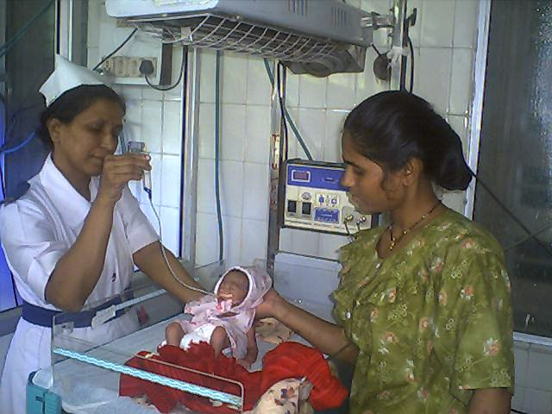
Method Of Feeding: Gavage or Tube Feeding
All babies less than 32 weeks gestation
Video on NG/ OG tube insertion & feeding to be added

Slide 20
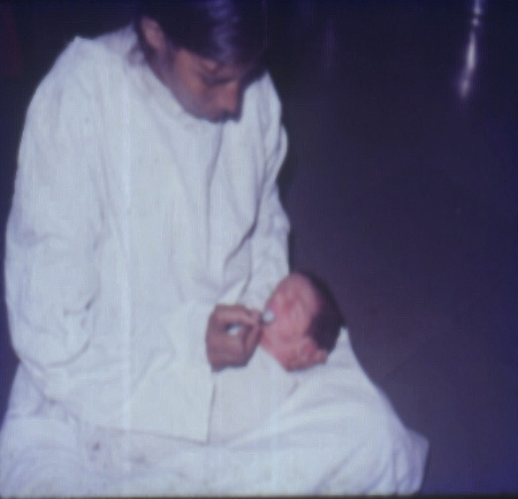
Transition To Wati Spoon / Paladai Feeding
Intermediate & late preterms may be breastfed right from birth, however initially many may require to be fed by wati & spoon or by paladai.
For smaller babies on gavage feeds:
As activity and periods of wakefulness increase:
Can begin wati-spoon / paladai feeds.
Preferable to keep RT in place till baby can take all feeds by mouth.
As the intake by mouth increases, the tube feeding can be decreased. Video of wati spoon / paladai feeding to be added

Slide 21
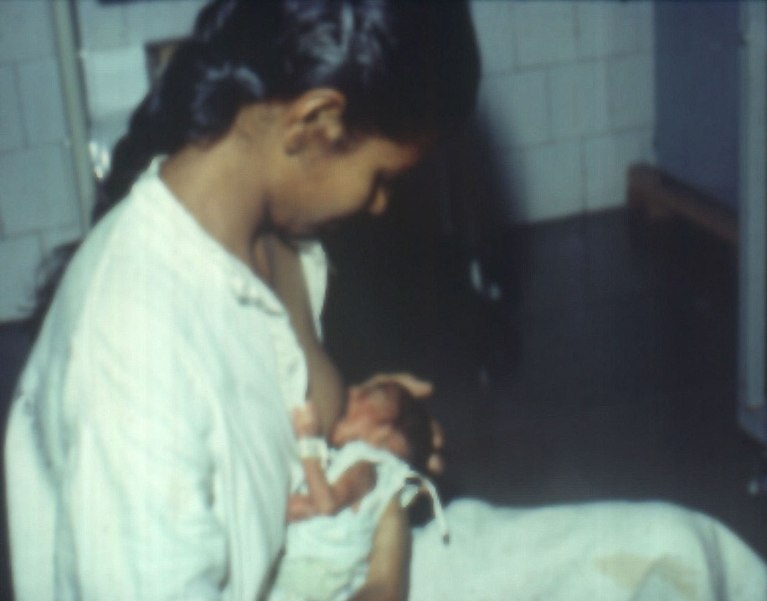
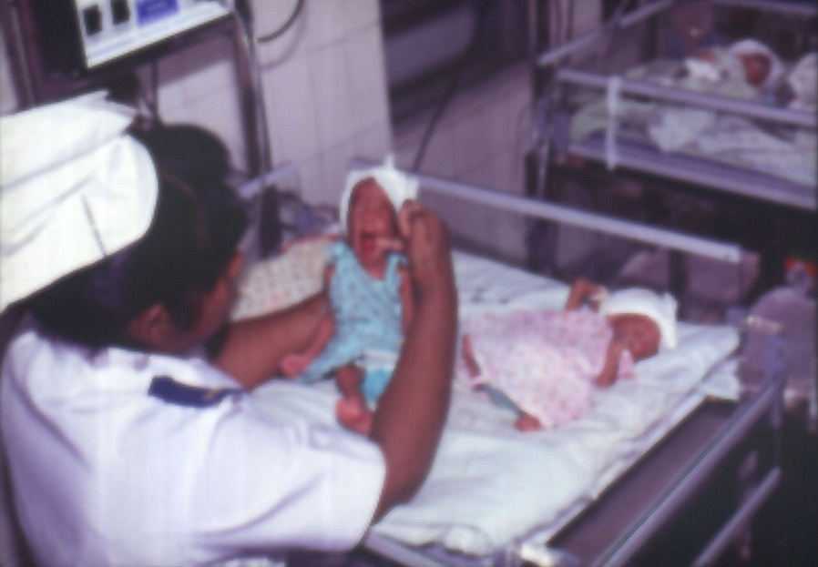
Transition To Breastfeeding
Effective breastfeed may take days or weeks .
BF can be tiring.
May need additional mother’s own EBM by wati spoon or paladai till velocity of weight gain is good.
Babies with good rooting and sucking reflex are able to breastfeed.

Slide 22

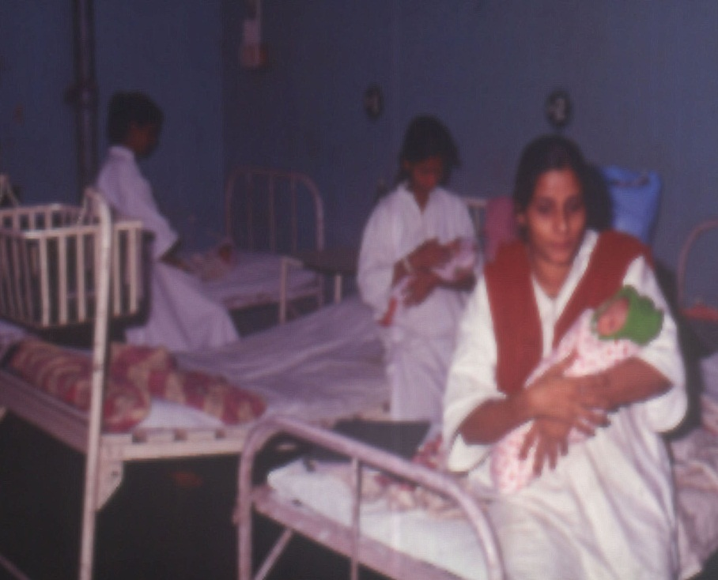
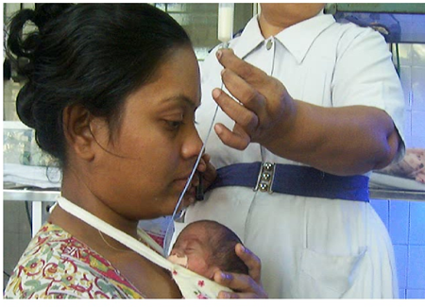
Enhancing Preterm Lactation & Transition To BF
Non nutritive Sucking
:Suckling at the empty breast
“Rooming In”Under Supervision
KMC

Slide 23
Growth Monitoring in VLBW Babies.
Initial weight loss:7-10%.Regained by 10- 14 days.
Desired goals:
Wt. Gain :15- 20 gm/kg/day. .
Length:0.9 cm/ week.
H. C.: 0.9cm/week.
(Anderson DM.Clin Perinatol:29,2002.)

Slide 24
Preterm Milk : Nutritional Concerns .
For VLBW babies unfortified mature human milk may fall short of
Energy
Proteins
Sodium
Ca & P
Fat soluble vitamins.

Slide 25
Nutritional Interventions
Use of Hind milk
Supplementation of individual nutrients: Ca, P, Multivitamins
Multi-nutrient fortifiers HMF

Slide 26
Mineral Supplements for Pre terms on Mother’s Milk?
Calcium :100-150mg/kg/day
Phosphorous : 50-75mg/kg/day
Iron : 2-4 mg/kg/day
Zinc :0.6mg/kg/day

Slide 27
Vitamin Supplements
Vitamin A 1000-1500 IU
Vitamin D 400 IU
Vitamin E 25 IU
Vitamin C 40-50 mg
Vitamin B1 1000 μg
Vitamin B12 3-5 μg
Niacin 5-10 mg
Folic acid 50 μg
Start when enteral intake 100-150 ml/kg/day

Slide 28
Causes Of Poor Weight Gain
Inadequate protein, calorie intake
Chronic cold stress
Anemia
Hyponatremia
Metabolic acidosis
Infection especially urinary tract infection or fungal infection
Inborn errors of metabolism (rare)

Slide 29
Multi Component Fortified Preterm Milk
Improvements in short-term growth .
Protein and energy supplementation associated with improved rates of weight gain .
Increased bone mineralization and linear growth Less feed intolerance, NEC , Infections compared to formula.
(Kuschel CA, Harding JE. Cochrane Library 1.2002.)

Slide 30
Fortification of Human Milk: Which Babies ?
Babies< 1250 gms especially < 1000gms
Babies with a difficult perinatal course
Babies requiring fluid restriction.
“Failure to thrive” despite intake of 180 ml/kg/day.

Slide 31
Human Milk Fortifiers Available In India
Per 1 gm sachet | Lactodex HMF | Hijam
Calories ( Kcal) | 3.63 | 3.5
Carbohydrates (g) | 0.42 | 0.05
Proteins(g) | 0.28 | 0.25
Fats (g) | 0.04 | 0.25
Calcium (mg) | 15.8 | 25
Phosphurus (mg) | 7.8 | 12.5
Iron (mg) | 0.3 | 0.36
Vitamin D (IU) | 133 | 100
1gm sachet of lactodex / 25 ml EBM provides additional
1.12 gm protein /100 ml, 14.22Kcal /100 ml of EBM

Slide 32
In Conclusion
Early enteral nutrition is important for VLBW babies optimal growth
Poor nutrition associated with EUGR
EUGR causes poor ND outcomes, increased risk of ROP, BPD
Preterm mothers milk is the best choice, PDHM next best alternative
Trophic feeding of EBM useful in sick newborns & ELBW.
Mineral & multi vitamin supplements essential
Fortification of breastmilk may be needed for ELBW & smaller VLBW infants.

